Slide 1
Project

Slide 2
agenda
Project Description
Images of Steps
Explanation of processes

Slide 3
Practical Description
I was tasked to create S3 event notifications using an SNS Topic on the AWS Management console. In this practical, I learnt how to create S3 buckets and also learnt how to create topics and event notifications.

Slide 4
Images of the Process
Creating Event Notifications in S3

Slide 5
Objective of the project
To configure Amazon S3 to automatically send notifications to an SNS Topic whenever certain events (like file uploads or deletions) occur in an S3 bucket. This enables real-time alerting or triggering of downstream actions in a scalable, decoupled, and serverless manner.

Slide 6
Services integrated
S3
SQS
SNS

Slide 7
S3 Functionality
Amazon S3 (Simple Storage Service) provides scalable object storage for any type of data. In this project, its functionality includes:
1) Storage: Securely stores files such as documents, images, videos, backups, etc.
2) Event Notification: Detects specific actions (e.g., file uploads, deletions) and generates events.

Slide 8
SQS Functionality
Amazon SQS (Simple Queue Service) is a fully managed message queuing service that enables decoupling and buffering of communication between different parts of a system.
1) Message Queueing: Receives and stores messages sent by other services (like S3 or SNS) until they are processed.

Slide 9
SNS Functionality
Message Distributor
Acts as a central hub that receives messages from sources like S3 and distributes them to multiple destinations (subscribers).
2) Supports Multiple Subscribers
SNS can send messages to:
Email addresses (email notifications)
SMS (text messages)
AWS Lambda functions
Amazon SQS queues
HTTP/S endpoints

Slide 10
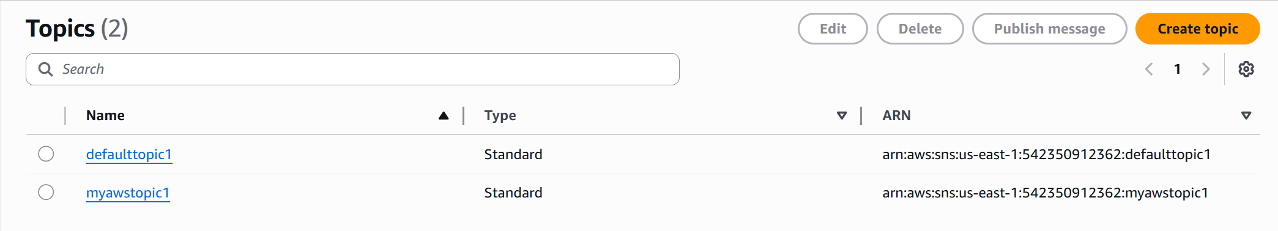
Step 1: Create A Topic

Slide 11
Explanation on How to create a topic
Step 1: Navigate to the SNS Service in the AWS Management Console
Step 2: Click on topic, and then create a topic
Step 3: Choose a topic type and give it a name and create it

Slide 12
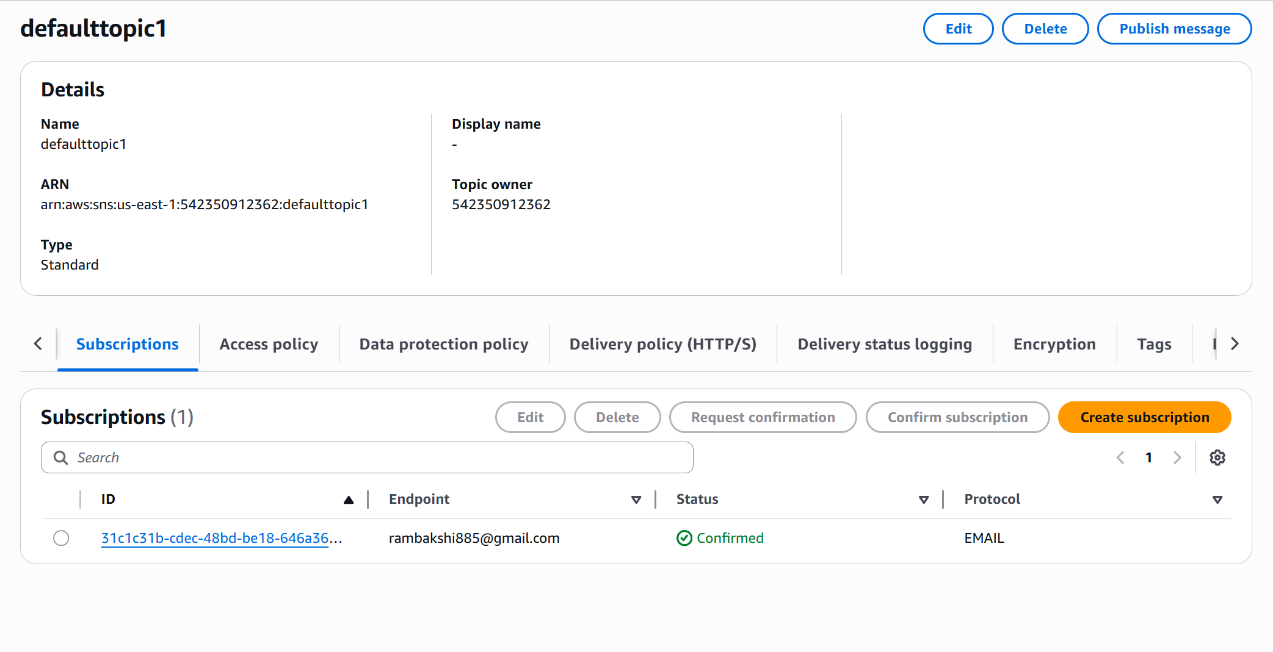
Step 2: Create a subscription

Slide 13
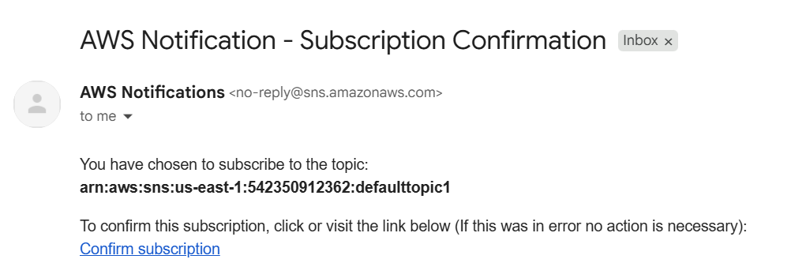
Step 3: Confirm subscription

Slide 14
Steps to create a subscription
Step 1: Create a subscription
Step 2: Select email for protocol
Step 3: Enter an email address for the endpoint
Step 4: Create a subscription
Step 5: Go to your inbox and confirm the subscription + refresh the page so that the status shows “confirmed”
Step 6: Navigate back to the topic, click on edit and edit the access policy to replace the default policy with that in the guide and make the necessary changes to the ARN components

Slide 15
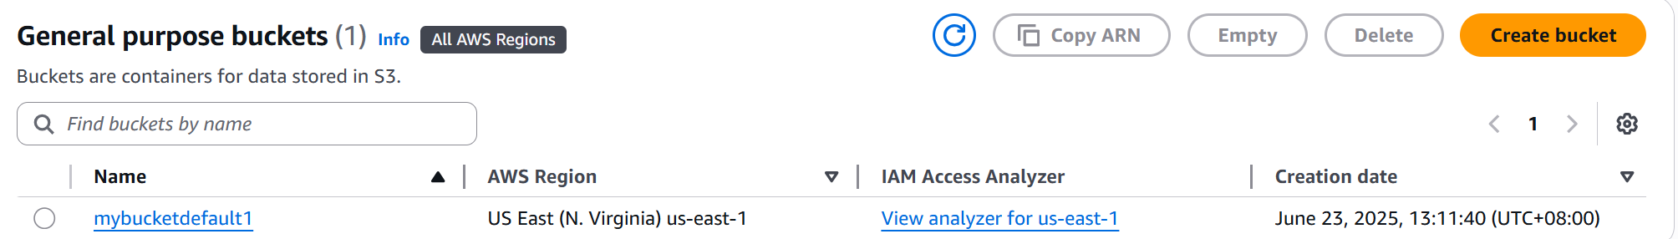
Step 4: Create an s3 bucket

Slide 16
Continued: s3 notifications
Step 1: Go to the events notification section of the S3 Bucket
Create an event notification
Give the event a name and then select all object create events
Select SNS Topic for the destination and then select the pre existing SNS Topic
When you upload something in the bucket, you should receive an email notification from AWS.

